Slide 1

Is NYC a Harbinger for Airbnb?
AI Boot Camp Project 1
TEAM MEMBERS:
Alan Khalili Danny Gallardo Ramona Ciobanu Sezan Prudence Hessou Vadim Bychock

Slide 2

Project Overview
This project analyzes Airbnb listing data for New York City to uncover insights about rental prices, listing distributions by neighborhood, and impacts of local laws on both Airbnb’s units and short-term housing.
Using Python libraries such as Pandas, Matplotlib, Numpy, Seaborn, Wordcloud, and Plotly, we perform data cleaning, visualization, and analysis to explore various dimensions of the dataset.

Slide 3
Questions
Goals/Questions to be addressed
Goal 1: Which neighborhoods and boroughs have the highest concentration of listings?
Goal 2: What is the average price of listings per neighborhood or neighborhood group?
Goal 3: Who are the hosts with the most listings?
Goal 4: New York City’s law restricting Airbnb’s short-term rentals – What was the goal, does it work, who benefits the most?

Slide 4
Overview of data collection, cleanup and exploration
Project Overview
Data Collection Process/ References:
Inside Airbnb – which is a site that scrapes the Airbnb website and advocates for affordable housing. The data stretches from July 2023 through April 2024, during which time the NYC law on short-term housing rentals went into effect.
Street Easy – is a site that tracks residential housing rates and inventory in NYC. This site was used to determine if there were any correlation between Airbnb listings and available housing.
Various other third parties including: NYC.gov, NYC Tourism, and the NYT for supporting data.
Cleanup Process and Exploration Process (EDA) – included:
Evaluating the Data Structures – which included data profiling via statistical analysis, evaluating the robustness of the types and volumes of data, data cleaning, as well as modifying object data types for visualization purposes.
Looking for Patterns and Trends – Using bar plots, scatter charts, pie charts and heatmaps, we found relationships we expected and more importantly, relationships we didn’t expect.
Looking for Outliers – because our work focused on medians vs averages, outliers were not as impactful.
Formulating Hypotheses – Because the patterns above were not always strong enough to create a hypotheses, the EDA process became iterative where we’d revisit the data, visualization patterns, and potential conclusions.
Notes:
evaluation and conversion of various data types and formats from objects to datetime.
Identification and removal of incomplete data (NaN, etc.).

Slide 5
Project Overview
Approach taken to achieve goals
Research
Group Discussion
Data Preparation (scraping & cleaning)
Analysis
Sorting Visualization
Data Comparisions
Additional Research
Further Discussion
Conclusions

Slide 6
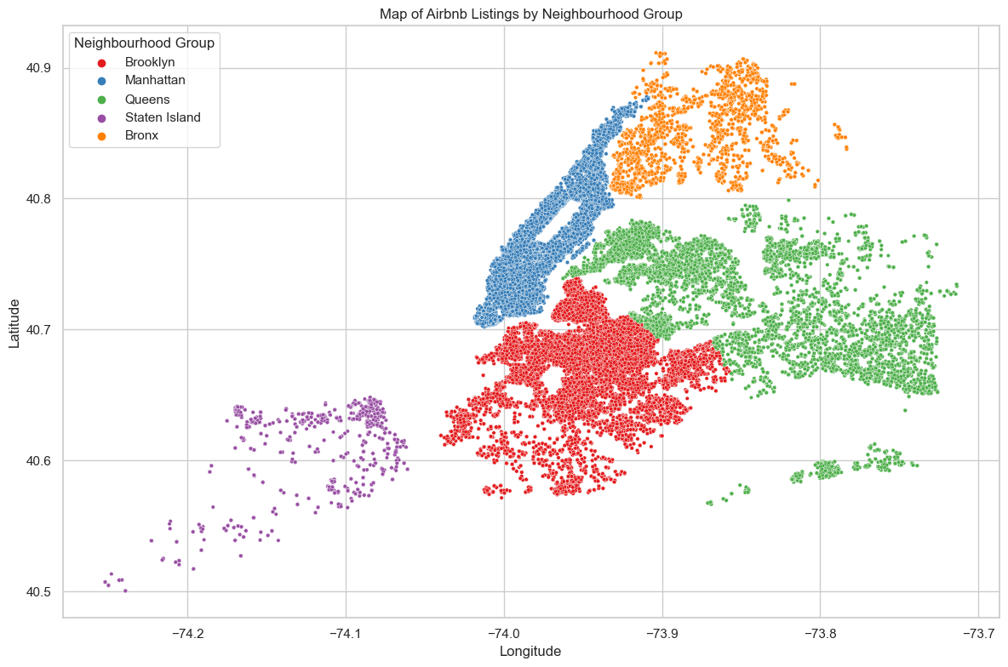
Overview

Slide 7
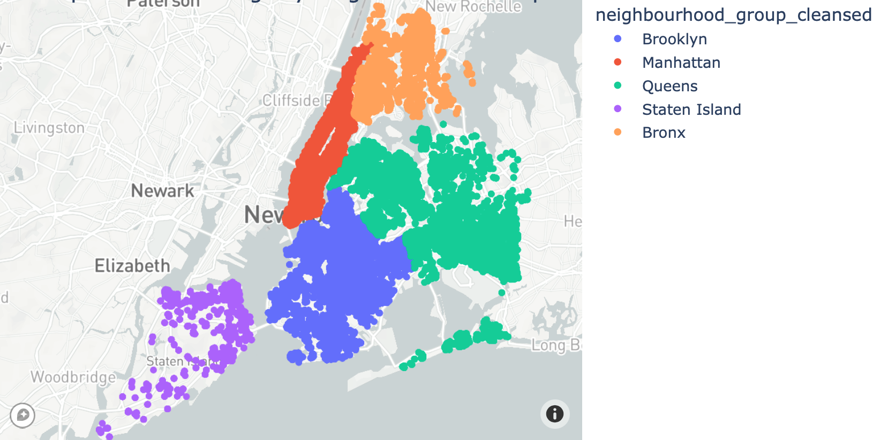
Overview
Arrows: Why are there no Airbnb listings there?

Slide 8
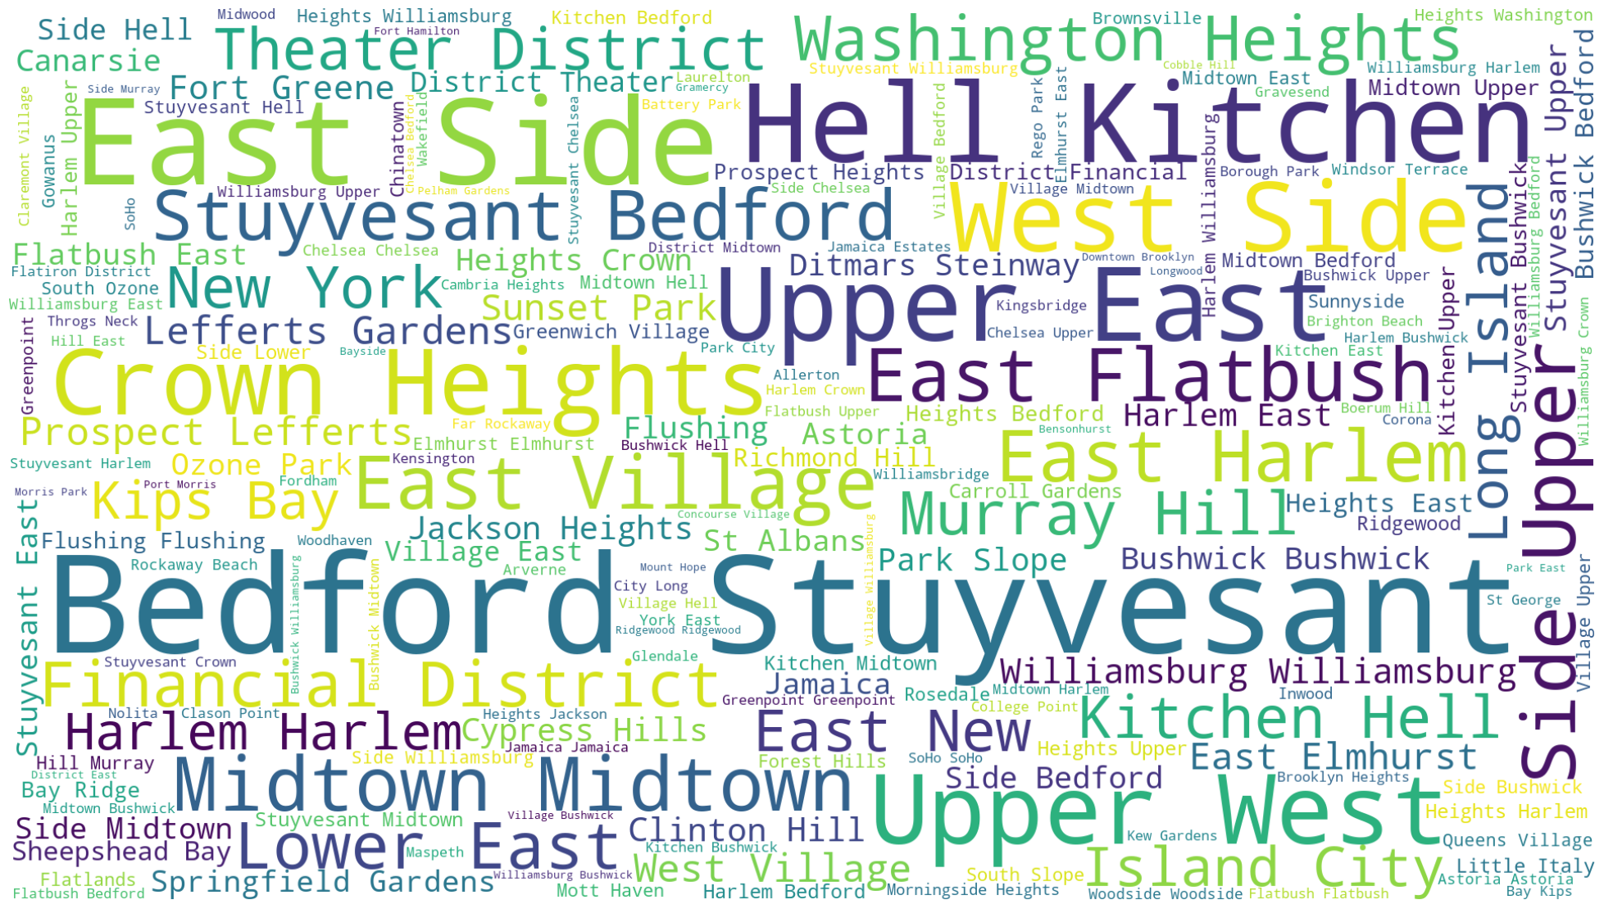

Slide 9
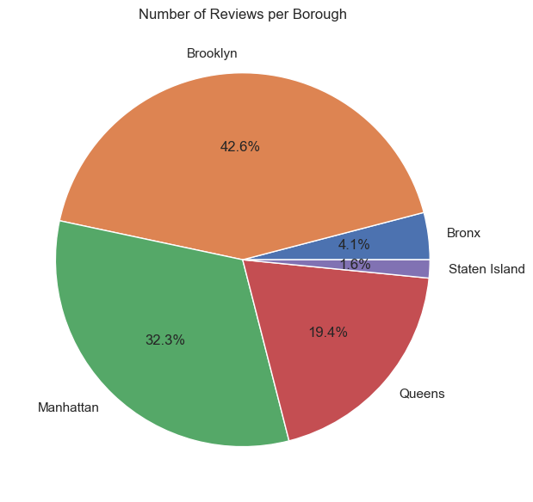
Reviews by Borough Analysis
Brooklyn Leads in Reviews:
Despite Manhattan having more listings, Brooklyn has the highest share of reviews at 42.6%. This suggests that guests in Brooklyn might be more engaged in providing feedback, or that the average length of stay and interaction level in Brooklyn listings is higher.
Manhattan’s Lower Review Share:
Manhattan, with a higher number of listings, has 32.3% of the reviews. This could indicate several factors:
Shorter Stays: Visitors to Manhattan might stay for shorter durations, reducing the likelihood of leaving reviews.
Higher Turnover: The high turnover rate in Manhattan's listings might result in fewer reviews per listing.
Different Guest Demographics: Guests in Manhattan might be less inclined to leave reviews, possibly due to a higher proportion of business travelers.

Slide 10
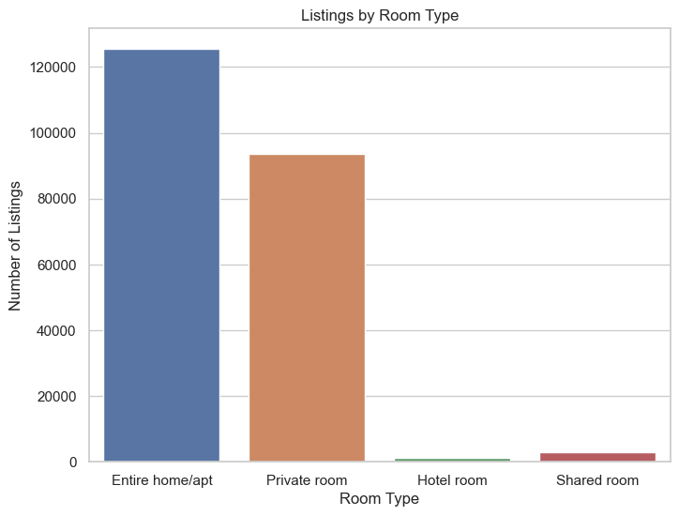
Room Type Analysis
Tourism and Business Travel: The high number of entire homes/apartments indicates a strong demand from tourists and business travelers who prefer the privacy and convenience of having an entire place
Impact on Housing Market: The significant number of entire homes/apartments being used for short-term rentals might reduce the availability of long-term rental properties, potentially driving up rental prices for residents
Affordable Options: Private room listings provide more affordable accommodation options for travelers, which can attract budget-conscious tourists and younger visitor
Income for Residents: This also suggests that many city residents are using Airbnb to supplement their income by renting out spare rooms

Slide 11
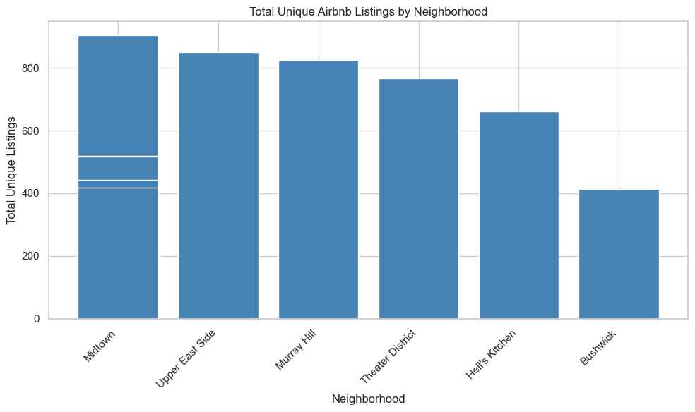
Neighborhood Analysis
Data analysis suggests that the neighborhoods with the highest concentration of listings across the five boroughs, are found in Manhattan NY, with Midtown taking the lead with 903 listings just in the past year. The below bar graph is a representation of the total unique Airbnb listings by neighborhood. The bars represent the number of listings in each neighborhood, making it easy to compare between them. It looks like Midtown, East Side, and Murray Hill have higher numbers of listings compared to neighborhoods like Hell's Kitchen and Bushwick.

Slide 12
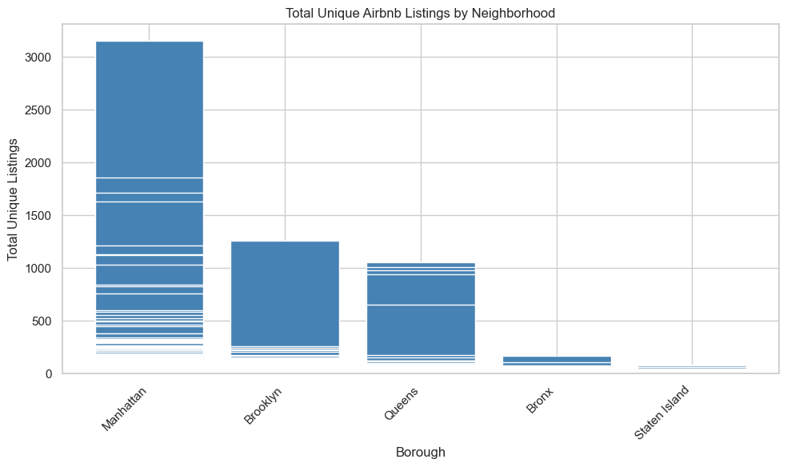
Borough Analysis
Furthermore, the following graph shows the total unique Airbnb listings across the five boroughs in New York City: Manhattan, Brooklyn, Queens, Bronx, and Staten Island. It appears that Manhattan has a significantly higher number of listings compared to the other boroughs, which is consistent with the general trend of higher tourist and transient populations there. Brooklyn follows with a moderate number, while Queens, Bronx, and especially Staten Island have fewer listings.

Slide 13
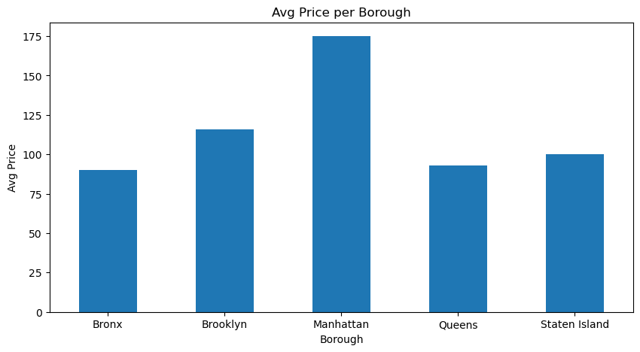
Pricing Analysis - Borough
Manhattan leads the average price of listings for our dataset with Brookyln being a close second.
The average price for Manhattan was hovering just below $175 while the others were hovering around the $90 - $125 range.

Slide 14
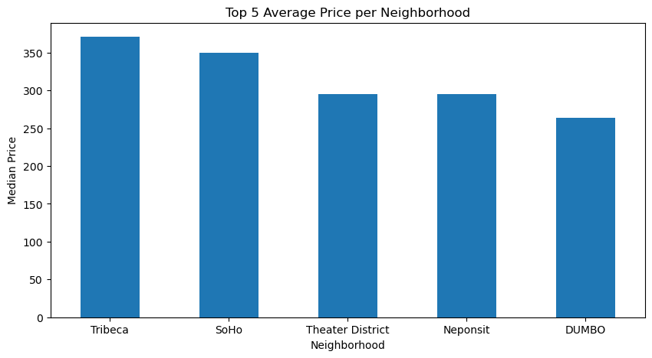
Pricing Analysis - Neighborhood
The median price for the top 5 neighborhoods hovered between $250 and $370.
Tribeca and Soho having the highest average prices.
The data we are seeing for neighborhoods is consistent with the data we are seeing for boroughs.

Slide 15
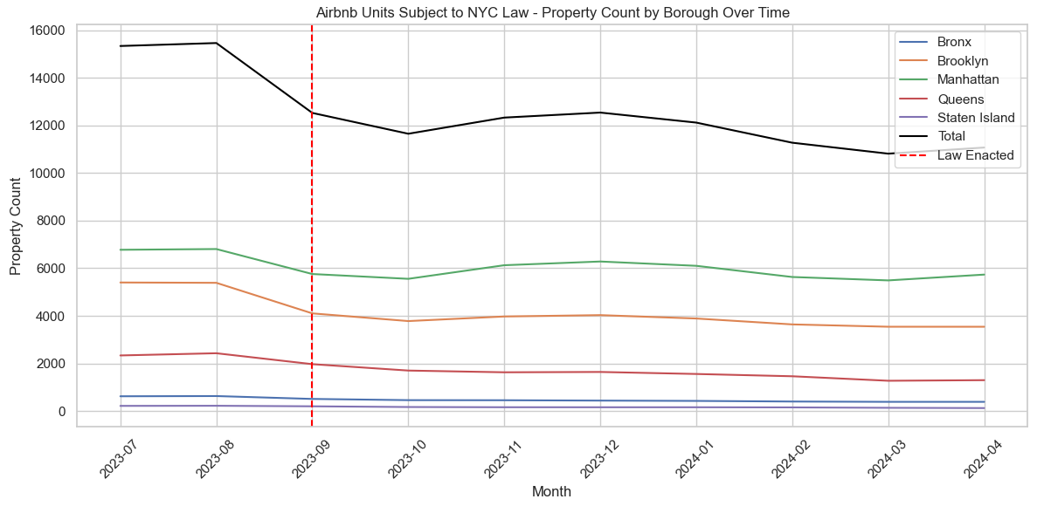
NYC Law Targeting Airbnb Rentals
Background:
NYC has a long-standing law prohibiting the rental of housing units for less than 30 days unless the owner is present.
Post the Airbnb/VBRO revolution, hotels have complained about lost revenues and citizens have complained about the lack of affordable housing for rent.
The law has gotten new teeth and cities around the world will be watching its effectiveness closely. Effective Sep 2023, renters of units that the owner isn’t present or lasts less than 30 days must register with the city or be subject to fines as much as $5,000 per occurrence.
What is the goal?
If the Airbnb units can’t be rented like a hotel room, the units will be used for long term housing and/or rental rates will go down.
Additionally, the reduced supply or rooms would increase hotel occupancy and possibly rates.
Did it work?
As expected, the number of Airbnb units impacted by the law did decrease

Slide 16
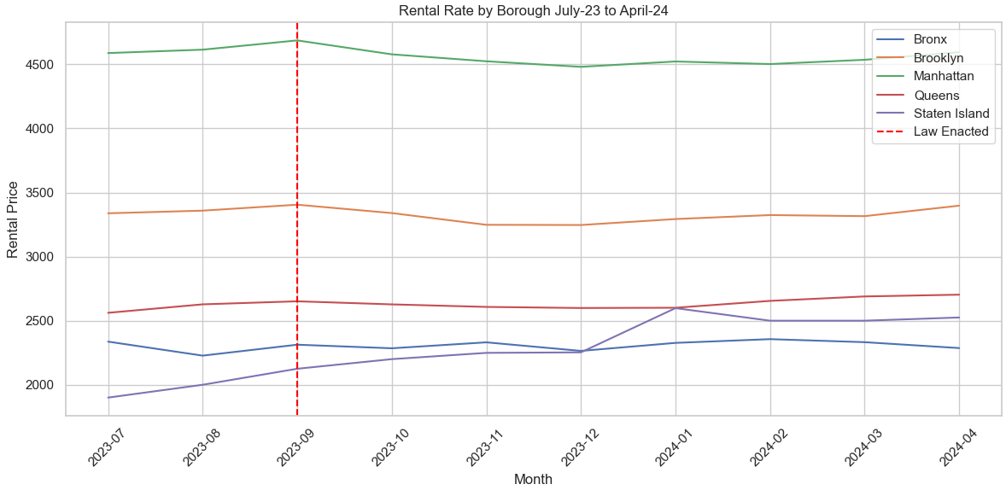
NYC Law: Did It Work?
Result/Conclusion 5
Did it work? Not in any measurable way.
Assuming the rental rate is a snapshot of where supply and demand meet, you can see below that the impact of the law on rental rates was minimal.

Slide 17
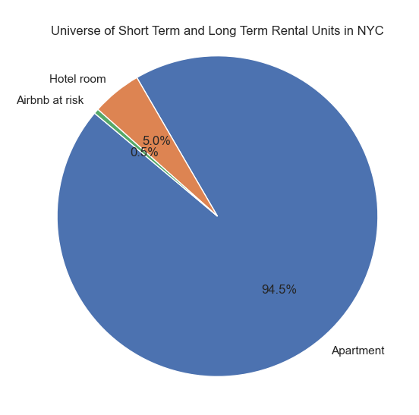
NYC Law: Who Benefited
Result/Conclusion 5
Why didn’t the law appear to work?
As of July ‘23, the Airbnb units that would be impacted by this law were only 12,000, which is ~10% of the available hotel rooms and .053% of the 2.3 million apartments.
Who benefited the most?
In a mature market such has NYC, the segment of short- term housing hosted by Airbnb alone, represented 10% of the rooms in the city. A 10% bump in occupancy could have a significant impact on the profitability of hotels.
For the hotel chains, a win in NYC could scale to other cities where they already have a presence.
“The Manhattan hotel market maintained an occupancy level above 80 percent in each month of the final three quarters of 2023, a first since 2019.”
Pwc’s Manhattan Lodging Index – Q4-23

Slide 18
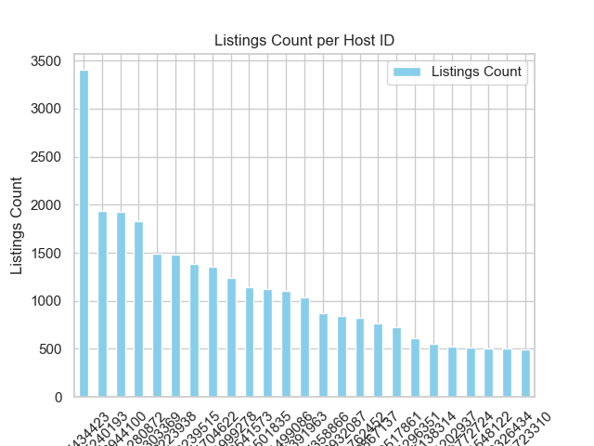
Host With The Most Listings

Slide 19
Summary
First: Use of various Pandas libraries to analyze NYC Airbnb data
Second: Time range for NYC Airbnb data used
Third: Analysis covered five major questions
a- Listing Dist./ Neighborhood
b- Listing Dist./ Neighborhood Groups
c- Average rental price
d- Host with the most Listings
e- Local laws and their impacts
Fourth: Methods Used To Attain Established Objectives

Slide 20
ISSUES ENCOUNTERED
Need for multiple data sources
Accurate identification of the right data set based on anticipated needs
Decision tree and criteria
Pros and cons of working as a group vs working individually
GitHub Repo's issues pulling and pushing
Delays caused by the need for the whole group to gather
Individual saving to the Images folder
Group synergy

Slide 21
Future Considerations
Examining the impact of the NYC law on hotel rates/occupancy
Accessing archived Airbnb data
Group budget for the ability to purchase reliable data
Opened channel with the Airbnb corporation or association

